Slide 1
Introduction to process
Reading Reference: Textbook 1 Chapter 2
Tanzir Ahmed CSCE 313 Summer 2020

Slide 2
Process Definition
Process is an instance of a running programming. This happens through its Abstraction
Also defined as “A Program in Action”
Provided by the OS and used by the program
To the OS, Process is a data structure (and more) representing a running program
Used to save a program’s state
A program can be kicked out and restored using it
To the program, Process is a view of the entire system – memory, CPU, disk and all I/O devices
Whatever the program needs, Process has it
Example: File handles, network socket etc. are kept inside the process
This view of the system is also called machine state

Slide 3
Process Data Structures
How does the OS represent a process in the kernel?
Using a data structure called Process Control Block (PCB)
Because of PCB, the OS can “kickout” a process and “bring it back” as if nothing has happened
process identification (use: to locate a processes) | process id parent process id user id
processor state information (use: to restore a processes as it was) | register set All general regs Specials (e.g., PC, SP, EFLAGS) condition codes Overflow, jump to take or not processor status
process control information (use: to treat/run a processes appropriately) | process state scheduling information event (wait-for) memory-mgmt information owned resources (e.g., list of opened files)

Slide 4
OS’s Internal Tables
An OS keeps a lot of information in the main memory, much of this info is about:
Resources (i.e., devices)
Running programs/processes
Note that program data is not same as PCB
PCB is more like a process’s metadata
Program’s data (variables, allocated memory) and code are kept elsewhere (i.e., address space)
PCBs of all processes

Slide 5
Abstraction Mechanism
Process provides each program with two key abstractions:
Logical control flow for CPU virtualization
Each program seems to have exclusive use of the CPU
Private address space for Memory virtualization
Each program seems to have exclusive use of main memory
How are these illusions maintained?
Process executions interleaved (multitasking)
Private address spaces managed by virtual memory system (will describe that in a bit)

Slide 6
Logical Control Flows
Each process has its own logical control flow, which can be far from reality
logical control flow
actual control flow
Process A
Process B
Process C
Process A
Process B
Process C
Time
Time
Control flows for concurrent processes are physically disjoint in time (except on multi-core machines)
However, we can think of concurrent processes as running in ‘parallel’ with each other

Slide 7
Logical Control Flow using Context Switch
Process A
Process B
process identification
Preempt Process A and store
all relevant information.
(idle)
Load information about
Process B and continue execution
processor state
information
(idle)
Preempt Process B and store
all relevant information.
process control
information
Load information about
Process A and continue execution
(idle)
Process Control Block
Notes:
Context switch

Slide 8
Private Address Space
First, every program needs to store and use some data
Declaring variables, allocating memory etc.
A program’s instructions also need to store
These data are kept in the disk, but need to be loaded to main memory before running the program
Now, how and where do we load these data?
Answer: the “Address Space” of the corresponding Process
The address space is also “private” (i.e., isolated from other processes)
Let us see how it works

Slide 9
Address Space
user stack
run-time heap
(managed by new/malloc)
A program’s data can be divided into different parts; therefore they are loaded as groups into memory
read/write segment
(e.g., global variables)
read-only segment
(e.g., code, constant variables)
Therefore, in very simple terms, the memory looks like the following with several programs loaded:

Slide 10
Private Address Space Illusion
But each process is made to believe that the memory looks like the following – thanks to Virtual Memory:
0xffffffff
user stack
(created at runtime)
%esp (stack pointer)
How big can this be?
memory mapped region for
shared libraries
Depends on machine architecture. For a 32 bit machine 2³² = 4GB
For a 64 bit machine 2⁶⁴ = 16EB
0x40000000
run-time heap
(managed by malloc)
brk
read/write segment
(.data, .bss)
loaded from the
executable file
read-only segment
(.init, .text, .rodata)
0x08048000
0
Kernel

Slide 11
Question
Is a process image really 2³² = 4GB long?
It would be nice for us, programmers
But typically, physical memory is quite limited
Virtual memory in action
What is then Virtual Memory?
For that, we now need to a little understanding on how memory is organized in a system

Slide 12
Memory Organization
Memory is logically divided into pages, which are fixed in size and aligned regions of memory
Typical size: 4KB/page
But pages are associated to a process only when necessary (i.e., read or written)
When not necessary, they are evicted to the disk
Thus a running process can be stored back to disk again!!!!
The mechanism of such lazy-allocation is through Page Fault
If a non-existent page is accessed (R/W), a page fault happens and fault-handler allocates the required page in physical memory
0-4095
Page 0
4KB
4096-8191
Page 1
8KB
8192-12287
Page 2
12KB
12288-16383
Page 3
…

Slide 13
Mapping from Virtual to Physical Memory
Virtual Memory
Physical Memory
Virtual Memory
0
Page Table
0K
Page Table
0
Page 0
Frame 0
Page 0
4K
4K
4K
Page 1
Frame 1
Page 1
8K
8K
8K
Page 2
Frame 2
12K
12K
Frame 3
16K
Frame 4
Private to Process #1
Of Process #2
2⁶⁴
2⁶⁴

Slide 14
Summarizing Virtual Memory
The private address space of a process is made up of pages
These pages can be spread according to the wish of the kernel
Contiguous memory in processes’ view are not necessarily contiguous in physical memory – they can be physically scattered, but stitched together by Virtual Memory system
Because memory is scarce, the whole private address space does not need to be allocated all the time:
Actual pages can be allocated/mapped only when needed (i.e., read or written) through page faults
Even allocated but inactive pages can be swapped back to disk to make room for more active pages
Memory accesses can be slowed down by Page Table accesses
Each address must be translated to physical address by looking up in the process’s page table, which is also in memory
Thus each memory access is actually 2 memory accesses: 1 for page table, another for the actual memory access
There is a cache called Translation Lookaside Buffer (TLB) which stores popular translations – thus hiding the double latency

Slide 15
Virtual Memory – An Interesting Video
Please watch this video, which is very informative, yet small:
https://www.youtube.com/watch?v=qlH4-oHnBb8

Slide 16
Process States - An Example
Assume the following processes A, B, C are loaded in memory
Assume we are not using Virtual Memory in this case
The processes are completely loaded in memory

Slide 17
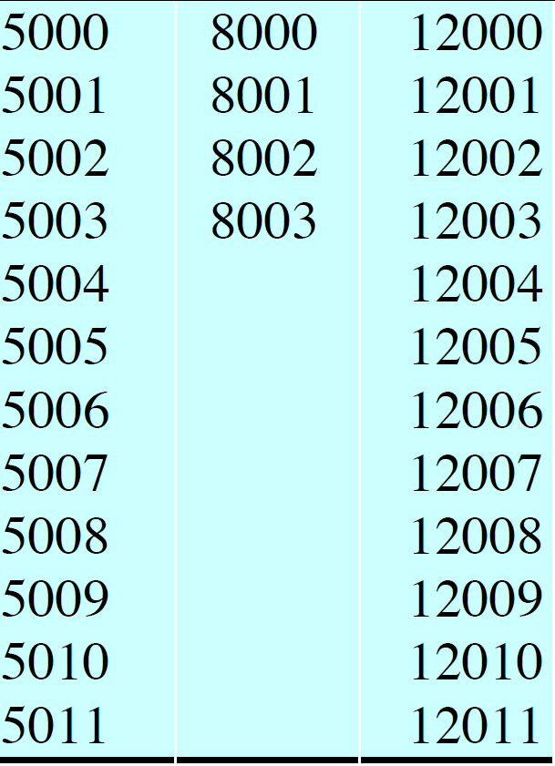
Process Trace
Trace: The sequence of instructions that execute for a process

Slide 18
Process Trace Discussion
Dispatcher is show in blue shaded box
The same dispatcher code runs between any 2 processes
The figure shows several (52) instruction cycles from the 3 processes
The trace starts with process A by overwriting PC with 5000, which is the first instruction of A
The OS allows exactly 6 instruction before the timer fires
i.e., kicks out the currently running process
This prevents programs from monopolizing the CPU
CPU goes from A to B after A is kicked out for the timer
B gets kicked out because of requesting I/O
Then the CPU alternates between A and C because B is still waiting for the I/O

Slide 19
Process States
Let us start with elementary 2-state model
This queue is some sort of a priority queue,
priority is based on some scheduling metric
Typical content of the Queue:
Pointer to PCB
Limitation:
Does not handle I/O operation well
Can bring a process that is still waiting on I/O
The process will stay idle

Slide 20
Refined Process State Model
It has 5 states
Newly added states: “New”, “Blocked”, “Exit”
Addition of “Blocked” state is obvious
Avoids bringing the process back to ready queue before I/O operation or the event actually finished
“New” state is when the PCB is created, but the process is not loaded in memory yet
Either because it is the usual delay
Or because there is no room in memory

Slide 21
Refined Process State Model (2)
Exit State: The process is removed from the list of executable processes, but it is held by the OS for collecting some information about it
E.g., an accounting program collecting information about all processes
New State: Is used for memory management
There might a limit on how many processes can be there in the main memory
The process’s PCB is in memory, but not its executable image

Slide 22
Now, the Transitions
New->Ready:
When there is room for a new process in memory
Ready->Running:
When the scheduler picks this process
Running->Exit:
Normal or due to some unavoidable/unrecoverable error (e.g., segmentation fault, divide by 0)
Running->Ready:
Timer fired
A low-priority process is running in CPU and a higher priority process got unblocked for I/O finish

Slide 23
Transitions
Running->Blocked
I/O or other event request that are not ready, or would take time
Blocked->Ready
Event on which the process is waiting has finished
Ready->Exit
Parent process terminates child before it could even run
Blocked->Exit
Parent process killed the child while it was waiting

Slide 24
Queueing Model for Proc. States
To implement the 5-state model, we will now need 2 queues
However, 2-queue model is also not enough
Does not make sense to make a file request from disk and URL request behind the Network card wait in the same queue
In reality, each I/O device, each lock, and thus each event needs a separate wait queue

Slide 25
Queueing Model (2)

